Slide 1
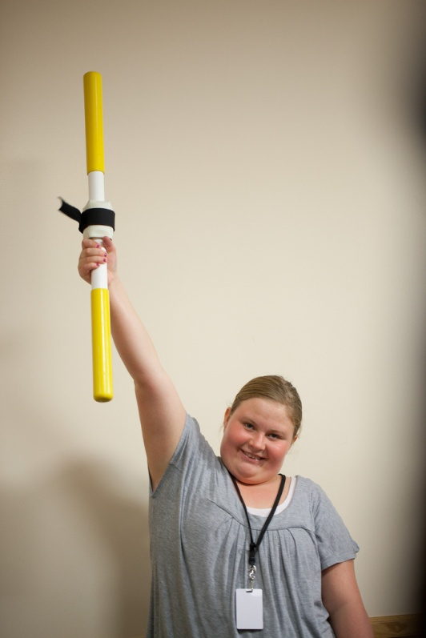
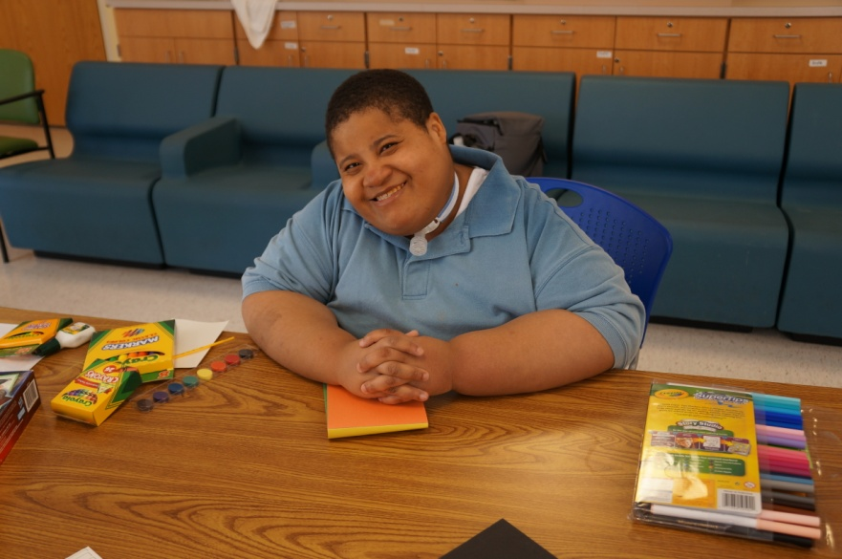

Slide 2
Professional Education and Consultation Services
Amy McTighe, Ph.D CABLE Coordinator/ Inpatient Teacher The Children’s Institute of Pittsburgh Center for Prader-Willi Syndrome

Slide 3
Introduction
The Children’s Institute of Pittsburgh’s/ Center for Prader-Willi Syndrome provides education sessions and consultation services for schools across the world
Topics to be covered:
How are education sessions delivered?
What topics are covered during sessions?
What consultation services are provided?
What are the fees for trainings and consultations?

Slide 4
Education Sessions- Delivery
Education sessions can be delivered in the following formats:
- Interactive video-conferencing
- On-site at the Children’s Institute
- On-site at the student’s school
Examples of equipment that can be used for video conferencing: Computer, Mobile Devices, or specific professional units purchased by the school

Slide 5
Education Sessions- Topics
Introduction to PWS
Behavior Supports for People with PWS
Everyday Activities to Improve the Quality of Life for People with PWS.
The School Setting for People with PWS
Nutrition for People with PWS
Exercise for People with PWS
Understanding Speech, Articulation and Swallowing for People with PWS

Slide 6
Consultation Services
One-on-One consultations are available for schools in need of guidance for a specific student.
Examples: IEP assistance, training for specific staff working with a student, problem solving in the school environment, environmental feedback in the school building
Provided at an hourly rate
Year long contracts with schools can occur
Consultation can include on-site training/feedback

Slide 7
Service Agreements and Fees
A service agreement is created and signed by both parties (CI and the school) that includes sessions to be delivered, fees, payment information
Option #1- Interactive videoconferencing
Option #2- On-site training at CI
Option #3- On-site training at CI and tour of the PWS Unit
Customized Training and Consultation

Slide 8
Contact Information
Amy McTighe, PhD CABLE Coordinator/ Inpatient Teacher (412) 420-2436 amt@the-institute.org
Maureen Schiavo Senior Planning & Marketing Analyst (412) 420-2535 mxs@the-institute.org

Slide 9
Disclaimer
While every effort is made to ensure that the training materials are updated with the most recent best practices and developments in the field of focus this may not always be possible. New developments may occur and it may not be possible to revise training materials immediately. Additionally, some statements and views in these materials may represent the opinions of the respected authors. The information in this training is not intended as legal advice and it should not be relied upon for legal purposes. The Children’s Institute expressly disclaims any liability for any direct or indirect damage resulting from the use of this training as a whole or parts thereof.

